Slide 1
Priority Queue
Dr. B C Dhara
Department of Information Technology
Jadavpur University

Slide 2
Consider the situation
a set of records collected, then the largest one is processed, then perhaps more records are collected, then the next largest one processed, and so forth.
  An appropriate data structure in such situation is one which supports the operations on inserting a new element and deleting the largest element.
    Such a data structure is called a priority queue.

Slide 3
A priority queue is a queue that supports accessing items from the largest to the smallest (or smallest to largest).
  A simple queue that supports accessing items in the items in the same order that they were added to the queue.
  A priority queue can be thought as a generalization of the stack and queue, as these data structures can be implemented with priority queues, using appropriate priority assignments.

Slide 4
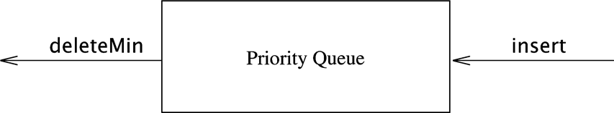

Slide 5
ADT Priority Queue
Priority queue supports the following operations
  Construct a priority queue from N given items
  Insert a new item
  Delete the largest item
  Replace the largest item with a new item
  Change the priority of an item
  Delete an arbitrarily specified item
  Join two priority queues into one large one

Slide 6
Priority Queue Implementation
Can be implemented by
  Link list
  Binary search tree (AVL tree, RBT)
  B-tree
  Heap

Slide 7
Partially Ordered Trees
Definition: A partially ordered tree is a tree T such that:
  There is an order relation >= defined for the vertices of T
  For any vertex p and any child c of p, p >= c

Slide 8
Partially Ordered Trees
Consequences:
  The largest element in a partially ordered tree is the root
  No conclusion can be drawn about the order of children

Slide 9
Heaps
Definition: A heap is a partially ordered, complete, binary tree
  The tree is completely filled on all levels except possibly the lowest
root
4
3
2
1
0

Slide 10
Heap example
Indexing from 0
Parent (k) = (k-1)/2
Left child of k = 2*k+1
Right child of k = 2*k + 2
A
B
C
D
E
F
G
H
I
J
A | B | C | D | E | F | G | H | I | J
0 | 1 | 2 | 3 | 4 | 5 | 6 | 7 | 8 | 9 | 10 | 11 | 12 | 13

Slide 11
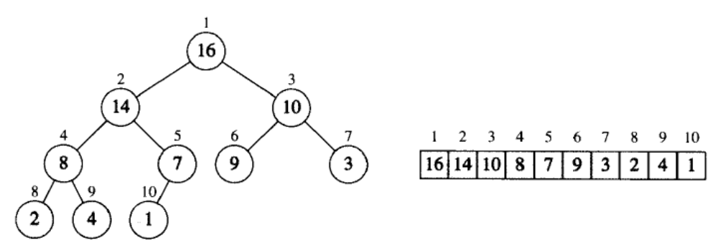
Heap example
Indexing starts from 1
parent(i) = ⎣i/2⎦
left(i) = 2*i; right(i) = 2*i +1

Slide 12
Application of heap
Heap can be used to sort the given data set
Heap can be also used as priority queue

Slide 13
Manipulating heap
We use HEAPIFY procedure to manipulate heap
  Input the array A and index i
  It assumes, tree rooted at left(i) and right(i) are heaps
  A[i] may be smaller than A[2*i] or A[2*i+1]
  The value at A[i] is floatdown to maintain heap at i

Slide 14
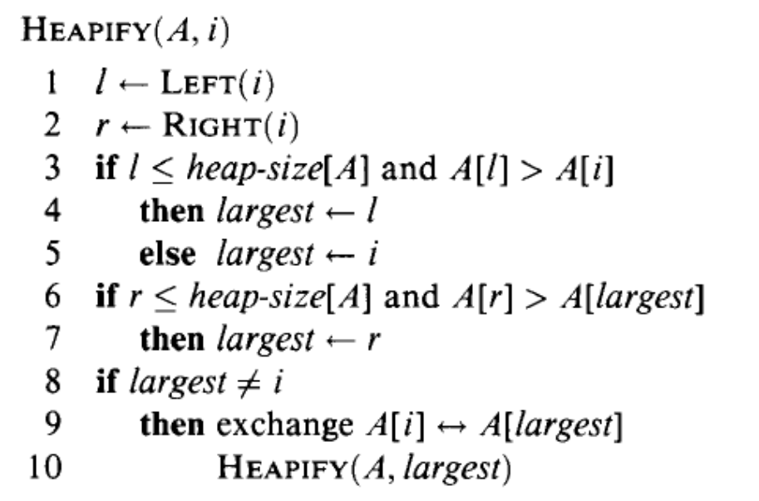
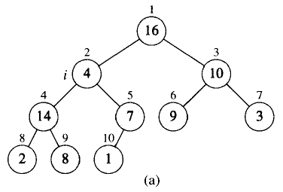
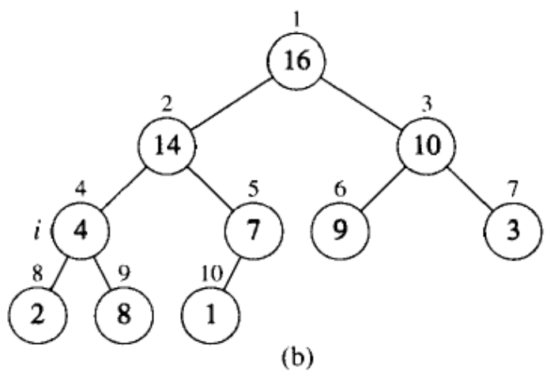
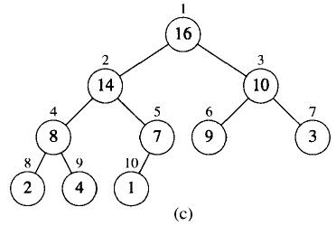
HEAPIFY

Slide 15
The complexity of HEAPIFY
  From line 1 to line 9, it is fixed, Θ(1)
  At line 10, recursive call for a subtree
  Number of nodes in a subtree is bounded by 2n/3, where n in the number of nodes in the given tree
T(n) ≤ T(2n/3) + Θ(1)
T(n) = O(lg n)

Slide 16
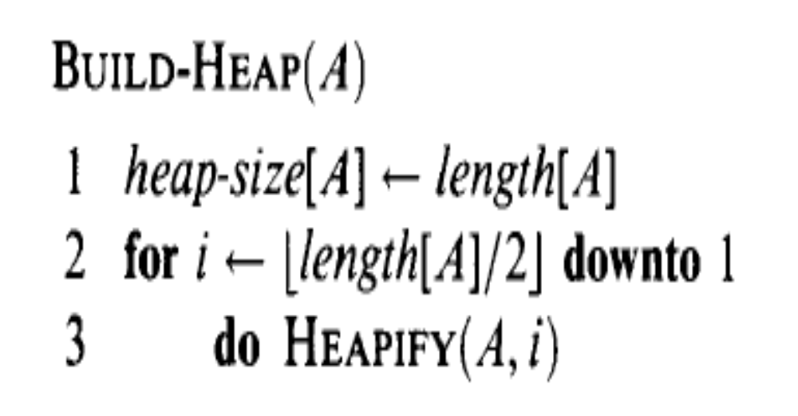
Initial heap
An array A with n elements
Each leaf node: a heap with single node
Intermediate node: the tree may not satisfy the heap
We call HEAPIFY for all intermediate nodes from ⎣n/2⎦ to 1.
HEAPIFY called O(n) times, so complexity of the initial heap is O(n. lg n)
This is a loose upper bound

Slide 17
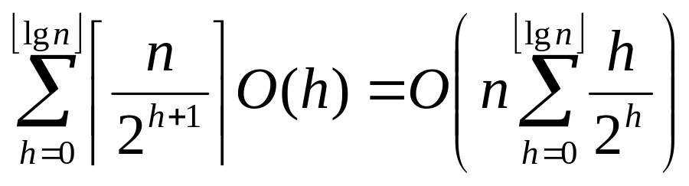
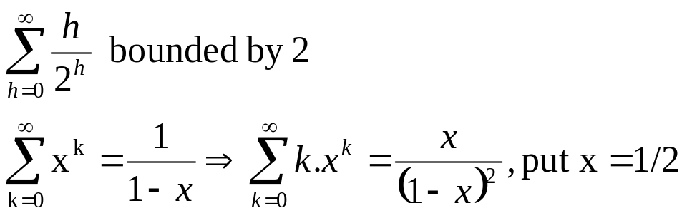
Initial heap
For tighter bound
Number of nodes at height ‘h’ in a n-heap is bounded by ⎡n/2^{h+1}⎤
Complexity of HEAPIFY for a nose at height ‘h’ is O(h)
Total cost of initial heap is
So, we can build a heap for an unordered array in linear time

Slide 18
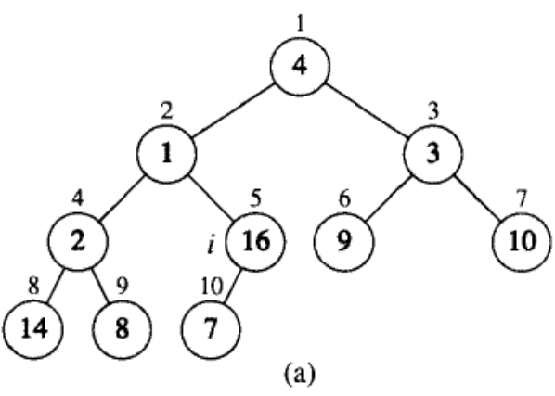
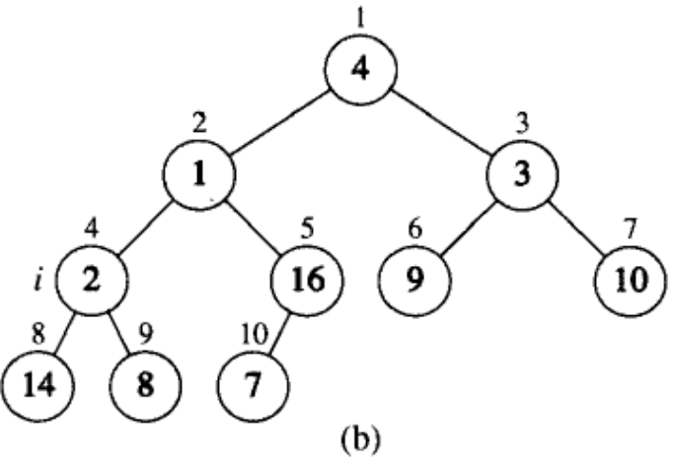
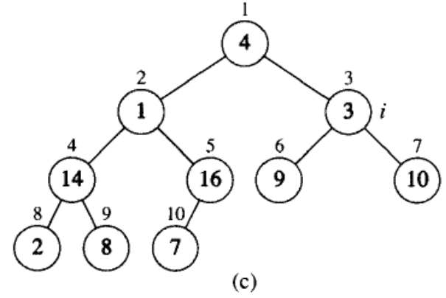
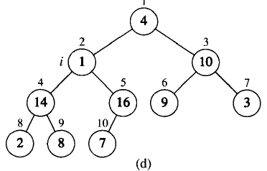


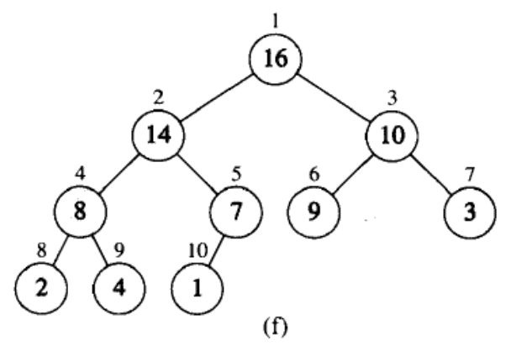
Initial heap

Slide 19
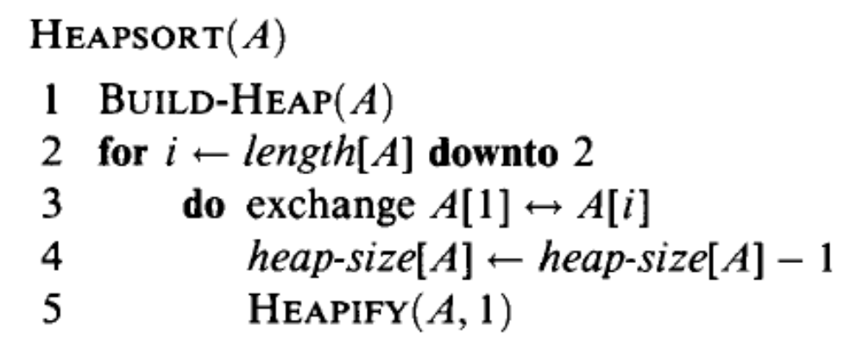
Heap sort
HEAPIFY called n-1 times with complexity O(lg n) in each iteration.
Complexity of the heap sort is O(n lg n)

Slide 20
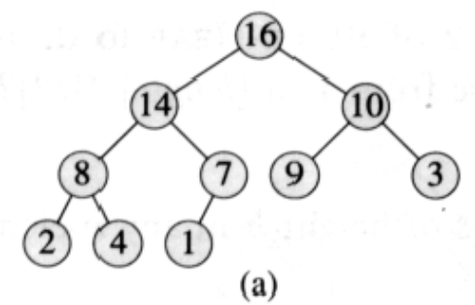
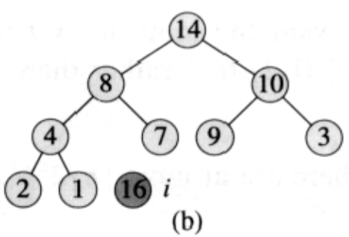
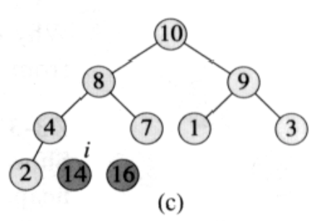
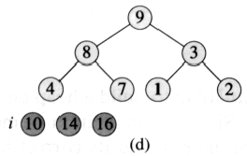
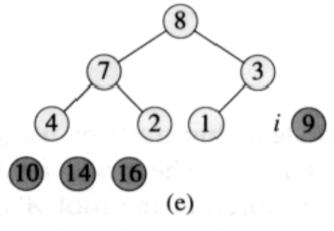
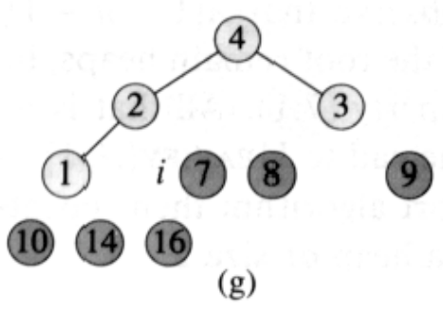
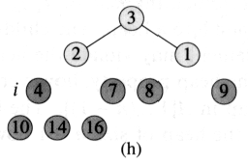
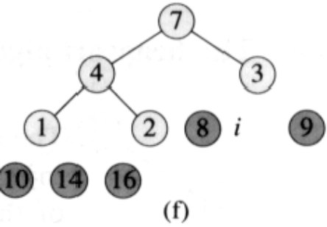
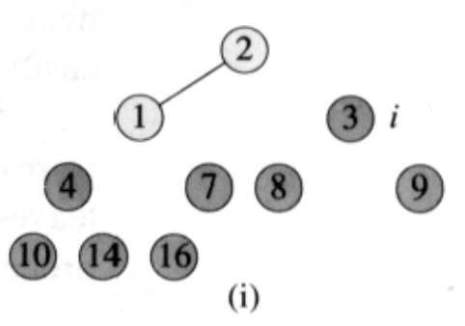
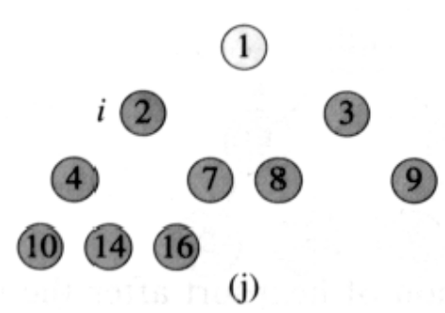
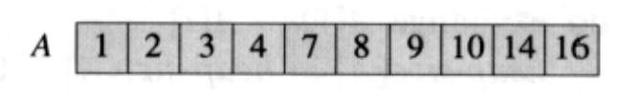
Heap sort

Slide 21
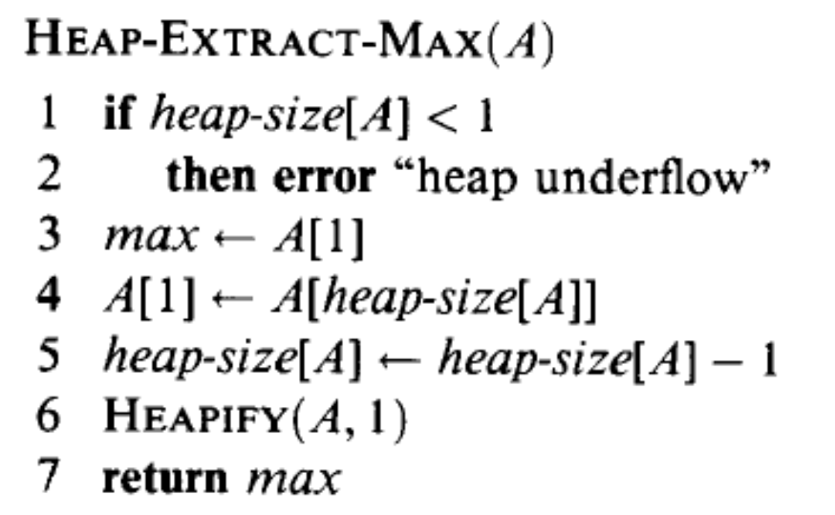
Priority queue
The operations are:
  Insertion
  deleteMax// HEAP-EXTARCT-MAX
In deleteMax, we have a max Heap and just remove the root value and call heap-reconstruction
RUNNING TIME OF O(lg n)

Slide 22
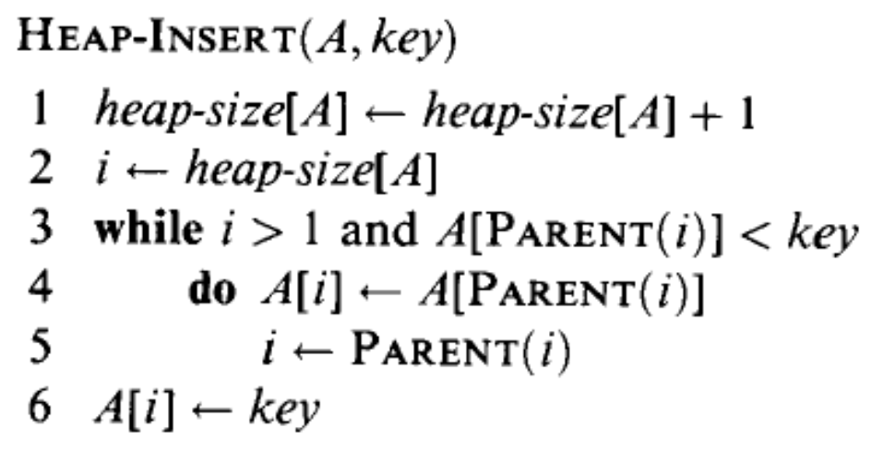
Priority queue
In insertion function, new element is inserted at the last position.
Then, along the path from new node to root maintain the heap property.
Complexity of the heap-insertion is O(lg n)

Slide 23
Heap insert
1
18
13
15
3
17
2
11
4
5
9
13
7
6
1
7
3
8
2
9
17
9
Key = 17

